Slide 1
Why Should Evangelicals Care?
Climate Change: It’s A Matter of Life!

Slide 2
The Bible tells us to care!
Defend the weak and the fatherless; uphold the cause of the poor and the oppressed. Rescue the weak and the needy (Psalm 82: 3-4 NIV).
The earth will take care of itself. It’s the most vulnerable that are suffering.

Slide 3
Creation Care: It’s A Matter Of Life
1 in 3 American Children suffer from Asthma, Autism, ADHD, or Severe Allergies^{1,2}

Slide 4
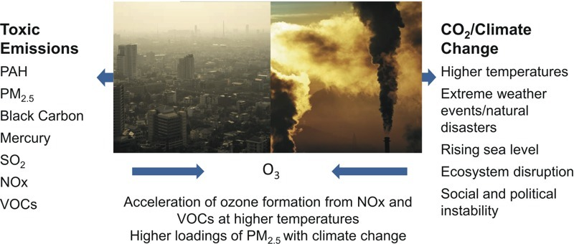
Why We Must Care For Our Children & God’s Creation
The 4A Epidemic is linked to fossil fuel & petrochemicals

Slide 5
State of The Air 2020
El Paso County Colorado – Colorado Springs
Ozone (Smog) = F
Pediatric Asthma =12,314
Cardiovascular Disease=30,212

Slide 6
State of The Air 2020
Ranked 63 for high ozone days
3.4 more days this year than 2019
#10: Denver-Aurora, CO
#19: Fort Collins, CO

Slide 7
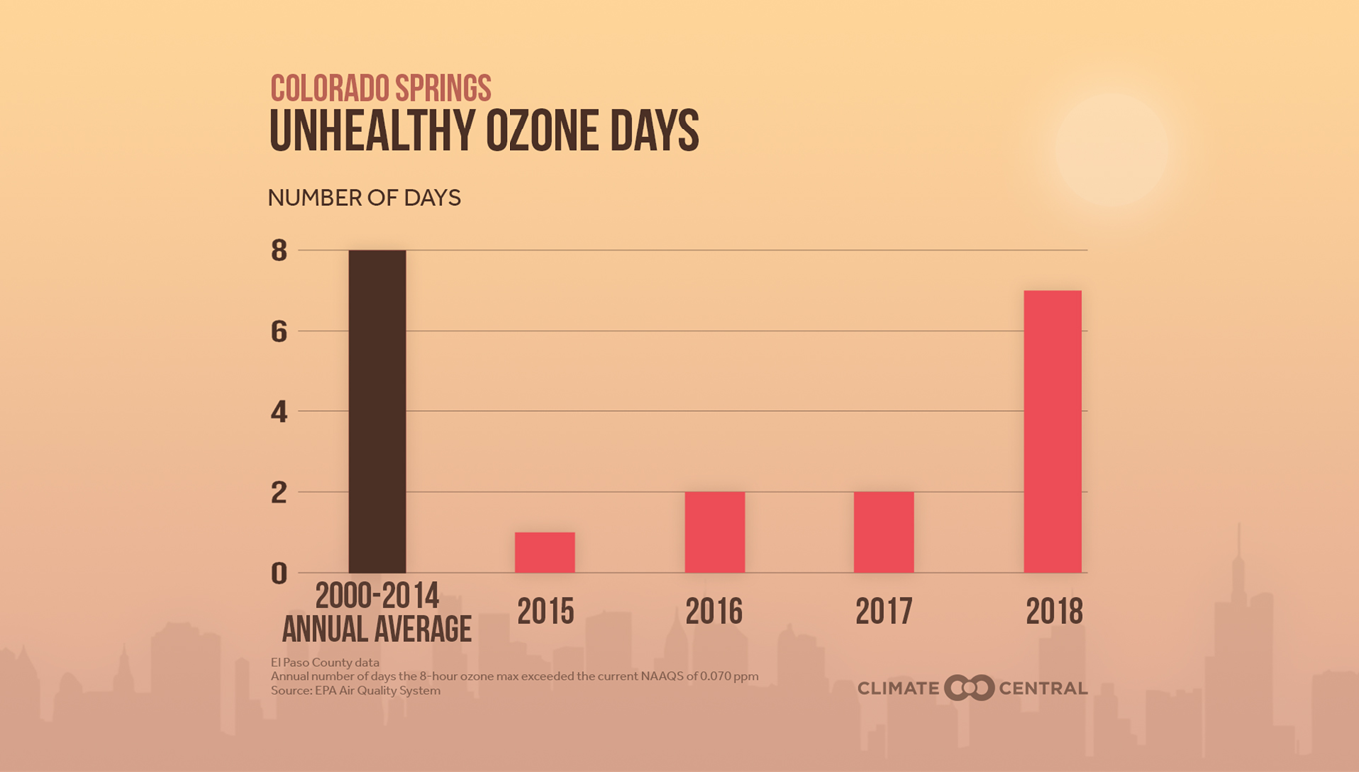

Slide 12
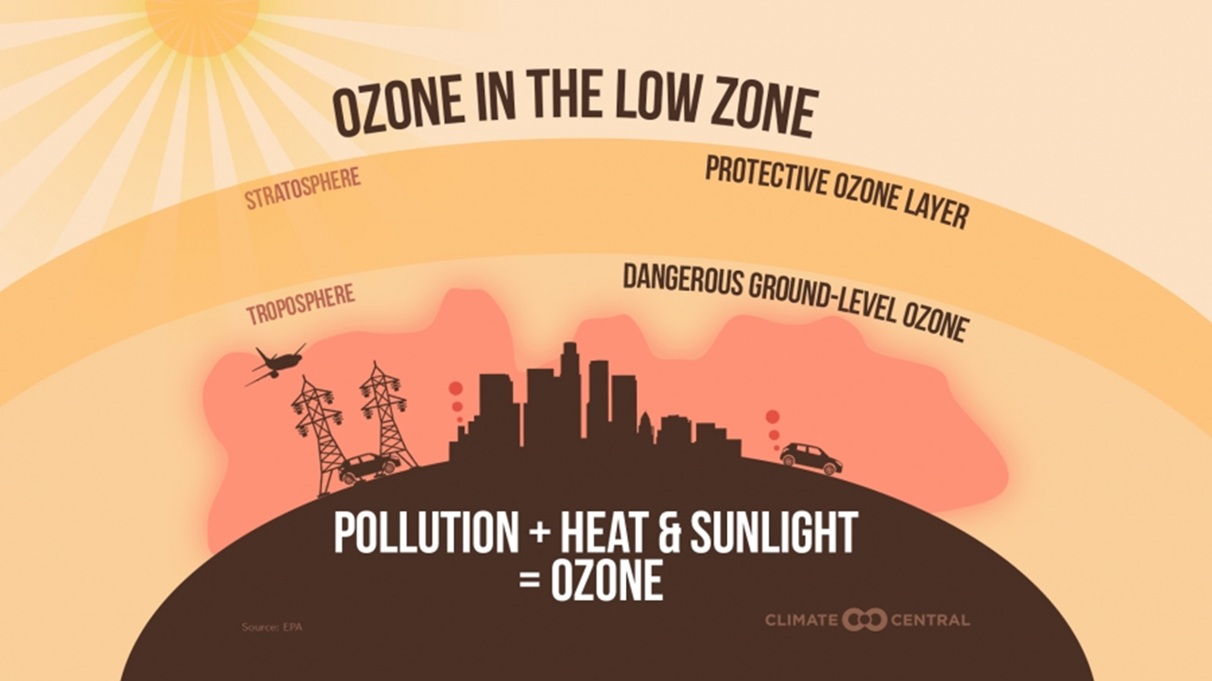

Slide 13
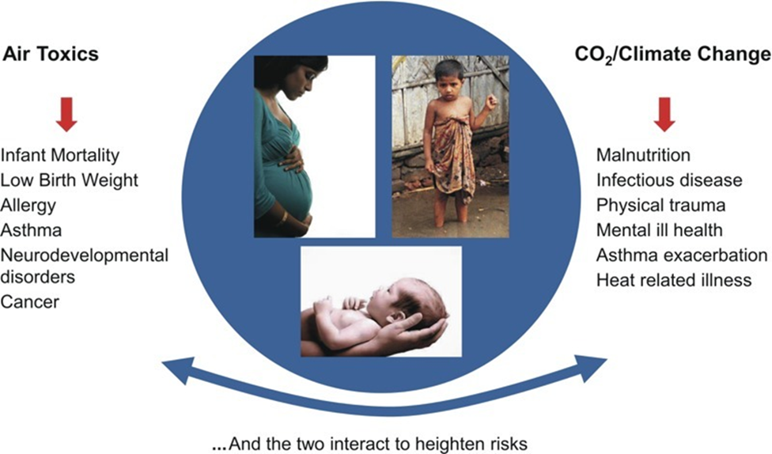
Perera FP. 2017. Multiple threats to child health from fossil fuel combustion: impacts of air pollution and climate change. Environ Health Perspect 125:141–148; http://dx.doi. org/10.1289/EHP299

Slide 14
State of The Air 2010 – Key Findings
Millions more Americans were living in communities impacted by unhealthy levels of pollution in the form of more unhealthy ozone days, more particle pollution days and higher annual particle

Slide 15
State of The Air 2010 – Key Findings
Nearly five in ten people—150 million Americans or approximately 45.8 percent of the population—live in counties with unhealthy ozone or particle pollution (at least one F).

Slide 16
State of The Air 2010 – Key Findings
That represents an increase from the past three reports: it is higher than the 141.1 million in the 2019 report (covering 2015-2017), 133.9 million in the 2018 report (covering 2014-2016)

Slide 17
State of The Air 2010 – Key Findings
and 125 million in the 2017 report (covering 2013-2015). More than 20.8 million people, or 6.4 percent of the population, live in the 14 counties that failed all three measures.

Slide 18
State of The Air 2010 – Key Findings
This shows growing evidence that a changing climate is making it harder to protect human health. All three years ranked among the five hottest years in history,

Slide 19
State of The Air 2010 – Key Findings
increasing high ozone days and widespread wildfires, putting millions more people at risk and adding challenges to the work cities are doing across the nation to clean up.

Slide 20
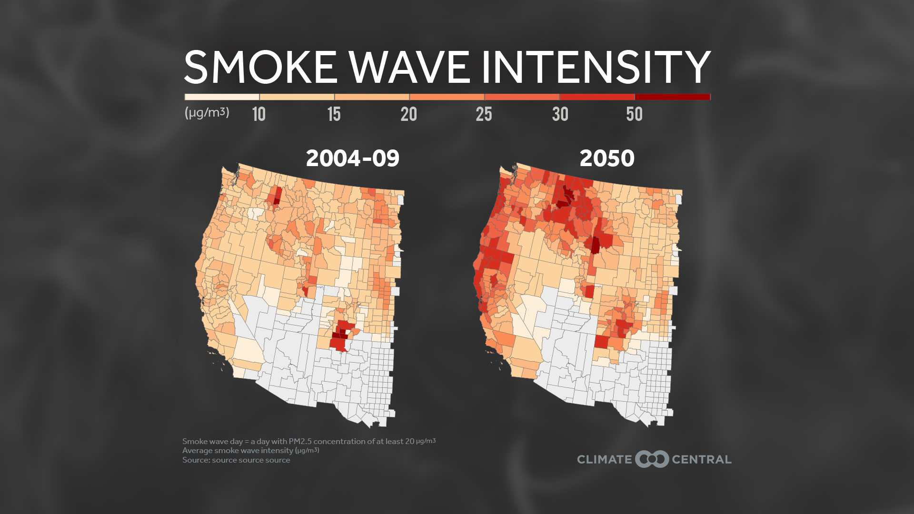

Slide 21
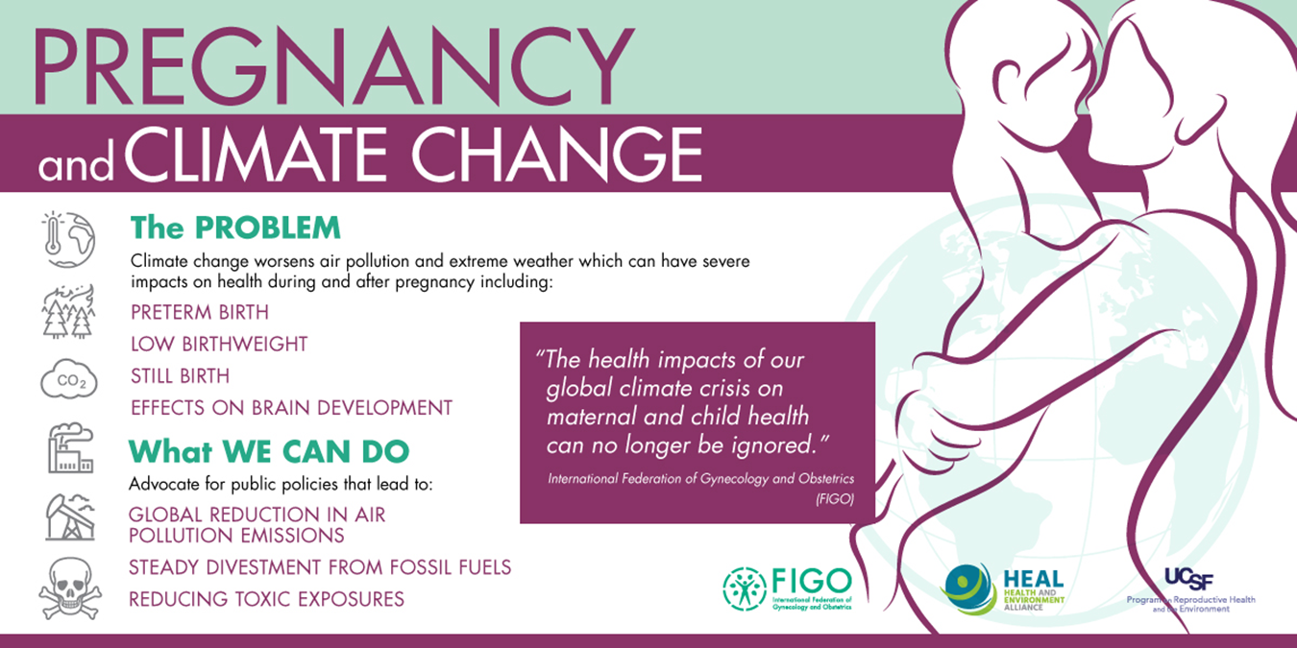

Slide 22
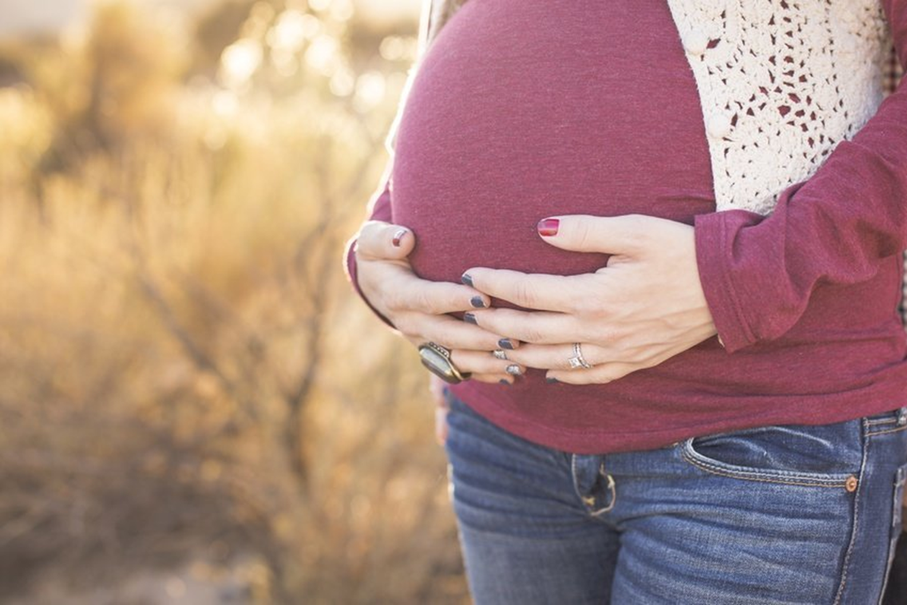
PM 2.5 (soot)resulted in 15,808 preterm births in the US
35% of pre-terms births result in death
$4.33 billion cost/yr.³

Slide 23
PM in small amounts:
Causes premature birth.
One of every nine births in the United States
One in six African-American births.⁴

Slide 25
Air Pollution Kills
107,000 Americans die air pollution each year.
$886 billion a year – on the health impacts caused by air pollution, especially from fine particulate matter known as PM 2.5.⁵

Slide 26
Air Pollution Kills
Other Studies place US Deaths From Air Pollution at 195,000 per year.⁶
EPA and DOE web site, the statistical value of an American life is $7.5 million

Slide 27
Air Pollution Kills & Value of Life
We are paying for fossil fuels for 195,000 lives per year
$7.5 million X 195,000 = $1.45 Trillion per year
Let’s pay in dollars instead with renewables

Slide 28
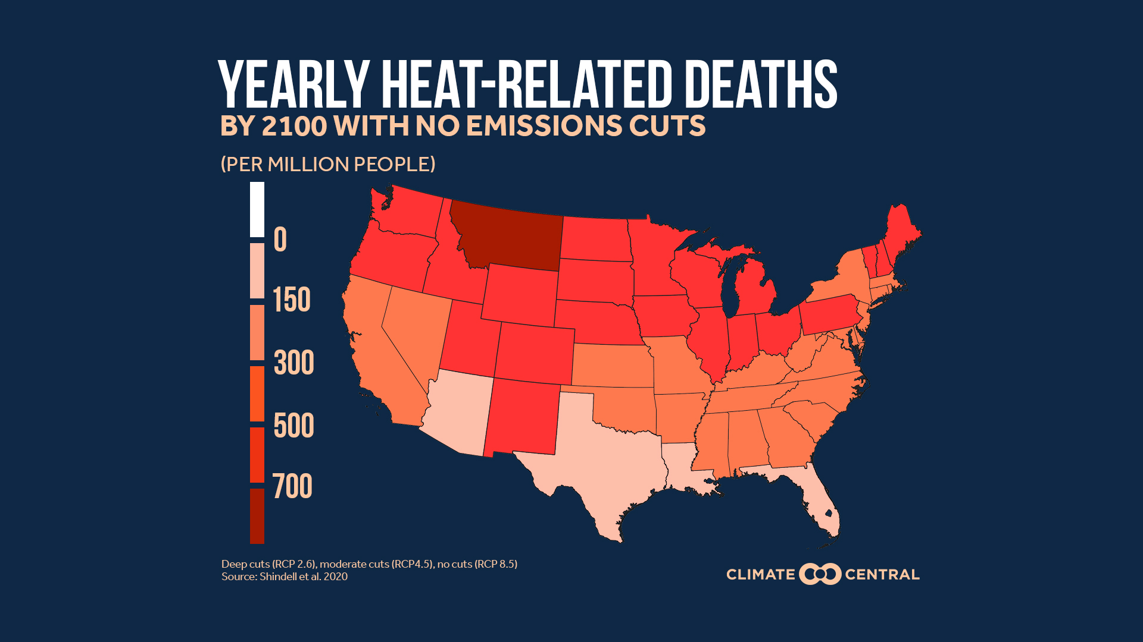

Slide 30
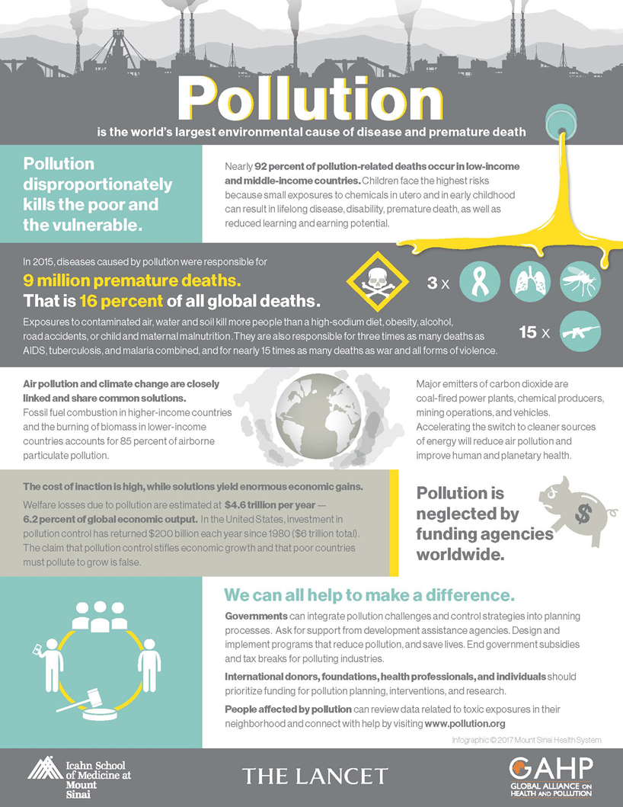

Slide 31
We have been poor tenants, failing to keep our covenant to care and tend God’s Creation
Leviticus 25:23 (NRSV)
The land shall not be sold in perpetuity, for the land is mine; with me you are but aliens and tenants.

Slide 32
Creation Care: It’s A Matter of Life
John 10:10 (NRSV)
The thief comes only to steal and kill and destroy. I came that they may have life, and have it abundantly.

Slide 33
References
¹Kenneth Bock, MD, Cameron Stauth, Healing the New Childhood Epidemics: Autism, ADHD, Asthma, and Allergies: The Groundbreaking Program for the 4-A Disorders, Random House, NY, 2007
²Bloom B, Jones LI, Freeman G. Summary health statistics for U.S. children: National Health Interview Survey, 2012. National Center for Health Statistics. Vital Health Stat 10(258). http://www.cdc.gov/nchs/data/series/sr_10/sr10_234.pdf
³Leonardo Trasande, Patrick Malecha, and Teresa M. Attina, Particulate Matter Exposure and Preterm Birth:
Estimates of U.S. Attributable Burden and Economic Costs, ENVIRONMENTAL HEALTH PERSPECTIVES, http://dx.doi.org/10.1289/ehp.1510810, March 2016
⁴Xiaobin Wang, Marsha Wills-Karp, Barry Zuckerman, Shyam Biswal, Colleen Pearson, Deanna Caruso, Guoying Wang, Huan He, Claire Sampankanpanich Soria, Zhu Chen, Xiumei Hong, Xingyou Zhang, Guangyun Mao, Rebecca Massa Nachman. Intrauterine Inflammation and Maternal Exposure to Ambient PM2.5 during Preconception and Specific Periods of Pregnancy: The Boston Birth Cohort.Environmental Health Perspectives, 2016; DOI: 10.1289/EHP243

Slide 34
References
⁵Inequity in consumption of goods and services adds to racial–ethnic disparities in air pollution exposure
Christopher W. Tessum, Joshua S. Apte, Andrew L. Goodkind, Nicholas Z. Muller, Kimberley A. Mullins, David A. Paolella, Stephen Polasky, Nathaniel P. Springer, Sumil K. Thakrar, Julian D. Marshall, and Jason D. Hill, PNAS March 26, 2019 116 (13) 6001-6006; first published March 11, 2019 https://doi.org/10.1073/pnas.1818859116
⁶J. Lelievelda, K. Klingmüllera , A. Pozzera , R. T. Burnettc , A. Hainesd , and V. Ramanathan, Effects of fossil fuel and total anthropogenic emission removal on public health and climate, Proceedings of the National Academy of Sciences Apr 2019, 116 (15) 7192-7197; DOI: 10.1073/pnas.1819989116

